Slide 1
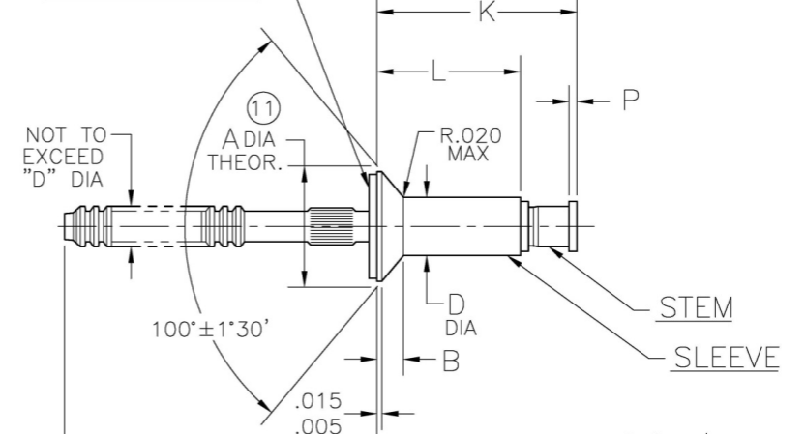
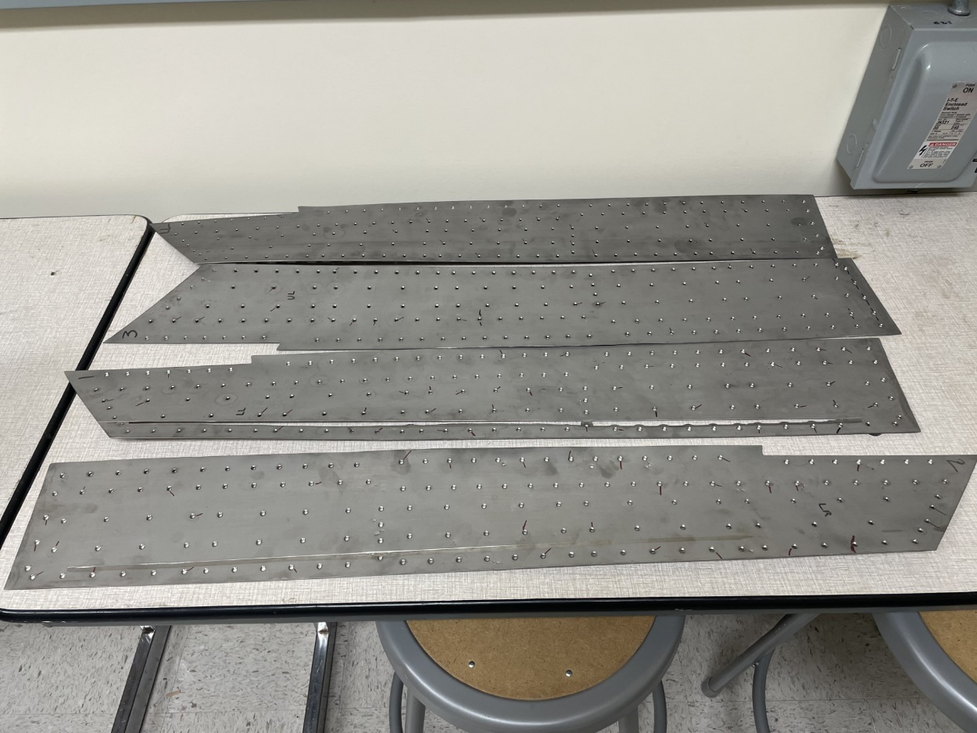
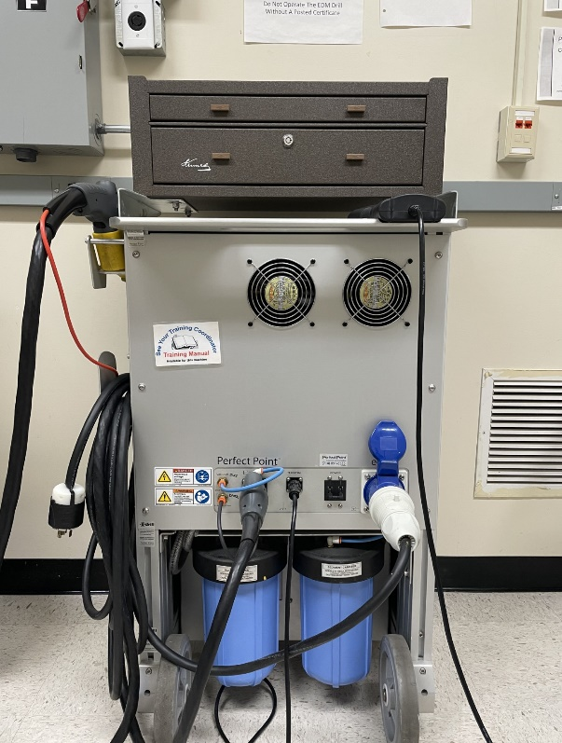
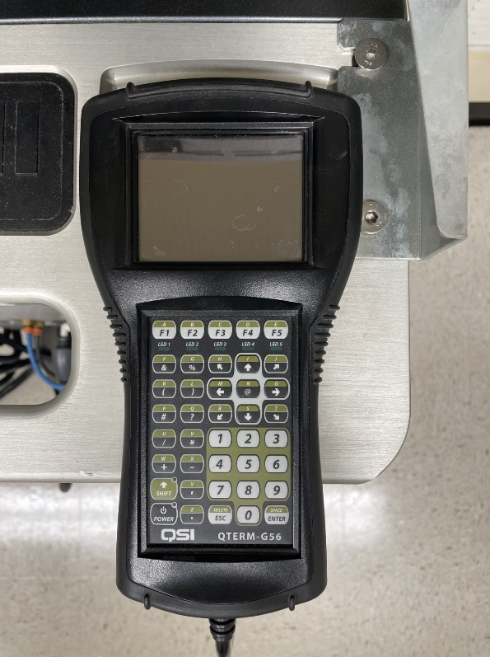
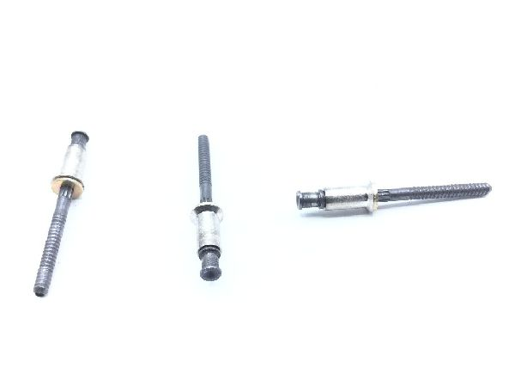
CRADA Out-Brief
Charter Progress
General student familiarization with E-Drill unit.
Found suitable alternative rivet for testing at OSU.
Confirmed with Perfect Point the correct electrode to use on alt. rivets.
Shipping E-Drill remote to be updated by Perfect Point (WIP).
Acquired the F-119 nozzle skin.
Next Phase
Basic concept ready for next phase of charter.
Notes:
Add notes here for detailed information

Slide 2
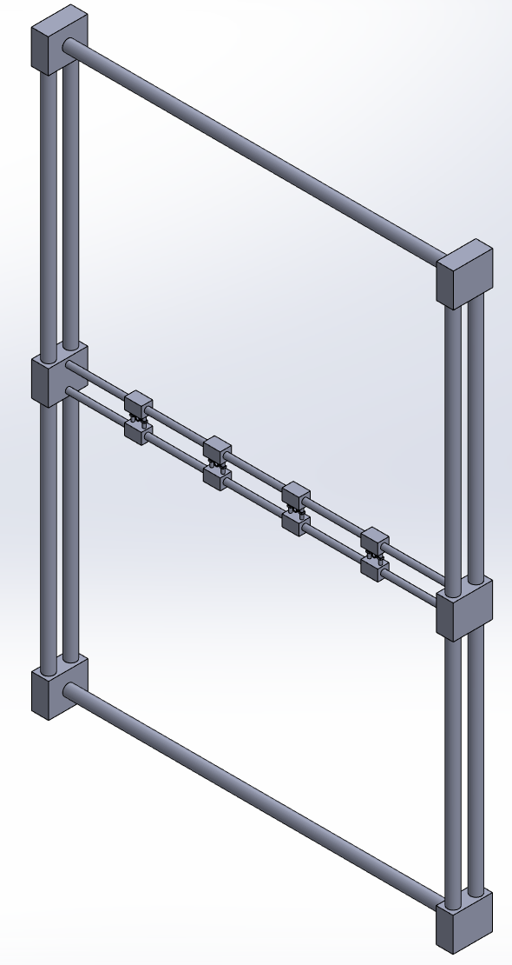
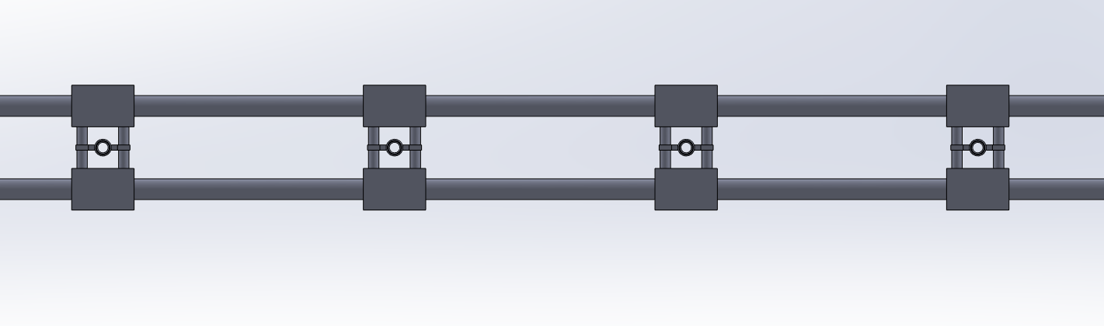
Next Phase
Initial Design
The technician will have the ability to position the locators in a single step, reducing repetitive motion.
Simple and cheap to manufacture.
Not to scale*

